Slide 1

Embedded Linux
By Mohamed Saied
With the references of the open-source world

Slide 2
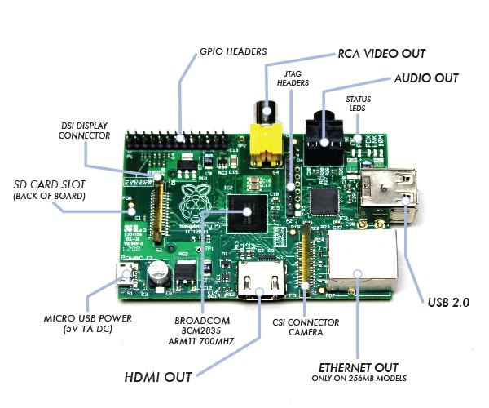

Slide 3
Why do we need OS
❖Reliability
❖Predictability
❖Performance
❖Compactness
❖Scalability

Slide 4

Linux History
the Unix operating system was conceived and implemented by Ken Thompson and Dennis Ritchie (both of AT&T Bell Laboratories) in 1969 and first released in 1970. Later they rewrote it in a new programming language C, to make it portable.

Slide 5
Embedded Systems
All systems that contain one or more processor to do
specific functionalities and give responses upon receiving inputs.
This processor is not for general purposes like general
purpose Processor in PC’s and notebooks.

Slide 6
Embedded Systems Cont’
The word embedded reflects the fact that these
systems are usually an integral part of a larger system,
known as the Embedding System. Multiple embedded
systems can coexist in an embedding system.

Slide 7
Embedded Linux Applications
Real time applications which needs a Human Machine Interface
Like Machines and User visualization in vehicles

Slide 8
Real Time Systems
Embedded Linux
Any computer system, embedded or otherwise, has timing requirements.
Any system which is required to perform its tasks within the time constraints of the system.
As system where the correctness of the output does not depend only on the calculations results, but it also depends on the time at which the output is produced.
8

Slide 9
Real Time Systems Architecture
Layered Arch.
Application SW
OS
Hardware

Slide 10
Types Of Real Time Systems
❖ Hard real-time system:
⮚ Also known as an immediate real-time system
⮚ The system that must operate within the confines of a
stringent deadline. It is considered to have failed if it does
not complete its function within the allowed time span.
⮚ Examples
• Car Air bag.
• anti-lock Braking Systems(ABS).
• aircraft control systems.

Slide 11
Types Of Real Time Systems..cont'd
❖ Soft real-time system:
⮚ The system that can operate with the presence of latency
at deadline.
⮚ It is not considered to have failed if it does not complete
its function at deadline but that affects the quality of the
output.
⮚ Examples
⮚ Video Processing
⮚ Audio processing
⮚ Digital cameras
⮚ Mobile phones

Slide 12
Concurrency
True Concurrent execution : Two or more tasks being executed at the same time
Pseudo Concurrent execution : The processor is switching between two or more tasks, each task is being executed for a small time slot and then the processor switches to the other task. This operation occurs with a very fast rate giving the impression that these tasks are being executed at the same time.

Slide 13
Process & Task
Processes:
Is a set of functionalities that is executed together at a certain
time
Tasks:
Is the build block of the real time architecture

Slide 14
Process & Task..cont’d
There is four deferent types of tasks:
Initialization task : executed only at the initialization of the system to initialize system components and peripherals
Cyclic task : once created it executes with fixed periodicity
Event based task : executed only if a specific event has occurred, this task is not triggered by interrupts.
Example : after the occurrence of a fault in the system it is
saved in EEPROM
Interrupt based task : executed only if a specific event has occurred, this task is triggered by interrupts, however it's not preferred to be executed in the ISR
14

Slide 15
Process & Task..cont’d
Multi-Tasking : is the execution of multiple tasks at the same time.
Resources : there are two types of resources
Software resources : variables
Hardware resources : peripherals, registers
Priorities : there are two types of priorities
Task Priorities
Interrupt Priorities

Slide 16
Context Switching
When the OS decides to switch to another task, it must save the CPU registers into the demolished task stack.
Once that happens the new task begin to restore its context from its storage area to begin the execution of the new task code.
Context switching apply overhead to the CPU, the more the CPU has register the more the overhead is applied.

Slide 17
Foreground VS Background Sys.
It called also super-loops systems.
An application consists of an infinite loop that calls modules to perform the desired operations (background).
Interrupt Service Routines (ISRs) handle asynchronous events (foreground)
“So the task level (Background) perform the main functionality, but the interrupt level (Foreground) perform the Asynchronous events “

Slide 18
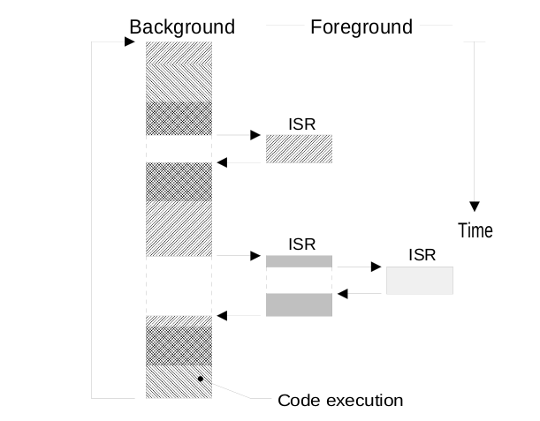
Foreground VS Background Sys.

Slide 19
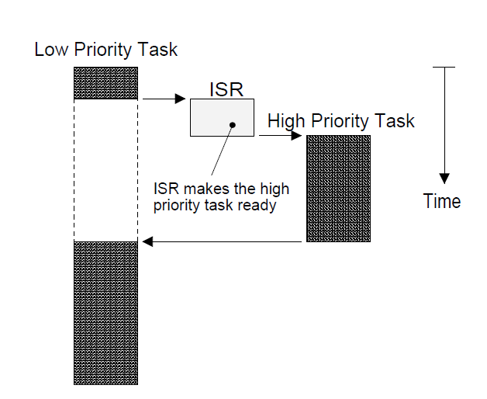
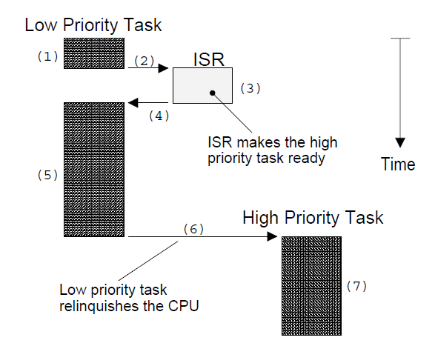
Scheduler
Preemptive Kernel
Non-preemptive Kernels

Slide 20
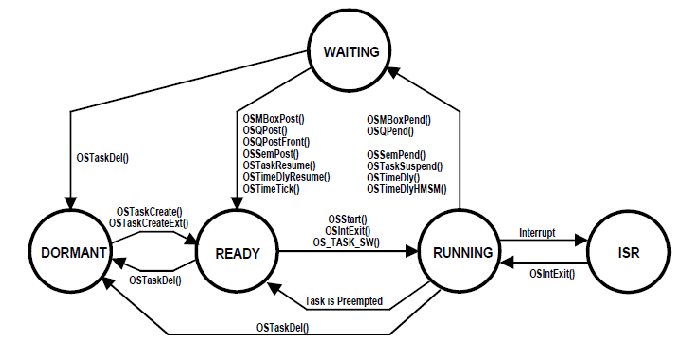
Task State

Slide 21
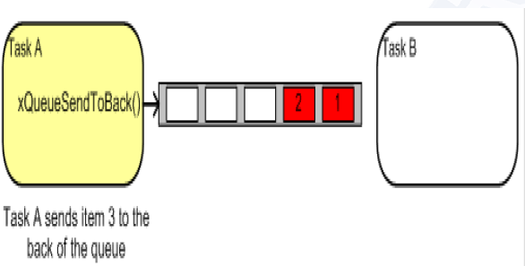
Queue

Slide 22
What is a Thread?
Technically, a thread is defined as an independent stream of instructions that can be scheduled to run as such by the operating system. But what does this mean?
To the software developer, the concept of a "procedure" that runs independently from its main program may best describe a thread.
To go one step further, imagine a main program (a.out) that contains a number of procedures. Then imagine all of these procedures being able to be scheduled to run simultaneously and/or independently by the operating system. That would describe a "multi-threaded" program.

Slide 23
How is this accomplished?
Before understanding a thread, one first needs to understand a UNIX process. A process is created by the operating system, and requires a fair amount of "overhead". Processes contain information about program resources and program execution state, including:
Process ID, process group ID, user ID, and group ID
Environment
Working directory.
Program instructions
Registers
Stack
Heap
File descriptors
Signal actions
Shared libraries
Inter-process communication tools (such as message queues, pipes, semaphores, or shared memory).

Slide 24
How Thread works?
Threads use and exist within these process resources, yet are able to be scheduled by the operating system and run as independent entities largely because they duplicate only the bare essential resources that enable them to exist as executable code.

Slide 25
Pthread memory management
Exists within a process and uses the process resources
Has its own independent flow of control as long as its parent process exists and the OS supports it
Duplicates only the essential resources it needs to be independently schedulable
May share the process resources with other threads that act equally independently (and dependently)
Dies if the parent process dies - or something similar
Is "lightweight" because most of the overhead has already been accomplished through the creation of its process.

Slide 26
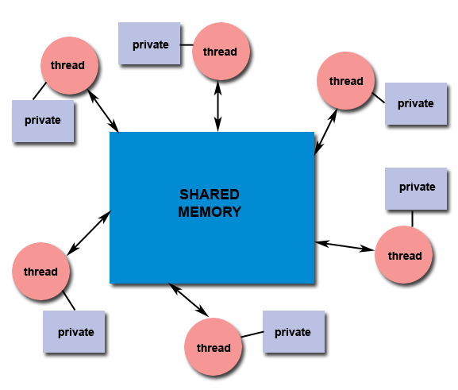
Shared Memory
All threads have access to the same global, shared memory
Threads also have their own private data
Programmers are responsible for synchronizing access (protecting) globally shared data.

Slide 27
Why Pthreads?
Light weight
When compared to the cost of creating and managing a process, a thread can be created with much less operating system overhead. Managing threads requires fewer system resources than managing processes.
For example, the following table compares timing results for the fork() subroutine and the pthread_create() subroutine. Timings reflect 50,000 process/thread creations, were performed with the time utility, and units are in seconds, no optimization flags.
Other Common Reasons:
Threaded applications offer potential performance gains and practical advantages over non-threaded applications in several other ways:
Overlapping CPU work with I/O: For example, a program may have sections where it is performing a long I/O operation. While one thread is waiting for an I/O system call to complete, CPU intensive work can be performed by other threads.
Priority/real-time scheduling: tasks which are more important can be scheduled to supersede or interrupt lower priority tasks.
Asynchronous event handling: tasks which service events of indeterminate frequency and duration can be interleaved. For example, a web server can both transfer data from previous requests and manage the arrival of new requests

Slide 28
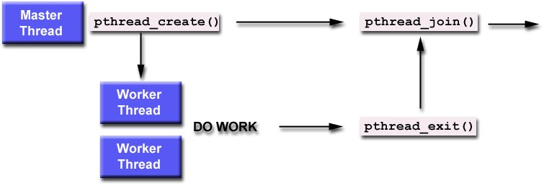
Thread Join
"Joining" is one way to accomplish synchronization between threads. For example:
The pthread_join() subroutine blocks the calling thread until the specified threadid thread terminates.

Slide 29
Joinable or Not?
When a thread is created, one of its attributes defines whether it is joinable or detached.
Only threads that are created as joinable can be joined. If a thread is created as detached,
it can never be joined.
The final draft of the POSIX standard specifies that threads should be created as joinable.
To explicitly create a thread as joinable or detached, the attr argument in
the pthread_create() routine is used. The typical 4 step process is:
Declare a pthread attribute variable of the pthread_attr_t data type
Initialize the attribute variable with pthread_attr_init()
Set the attribute detached status with pthread_attr_setdetachstate()
When done, free library resources used by the attribute with pthread_attr_destroy()

Slide 30
Mutex
Mutex is an abbreviation for "mutual exclusion".
Mutex variables are one of the primary means of implementing thread synchronization
and for protecting shared data when multiple writes occur.
A mutex variable acts like a "lock" protecting access to a shared data resource.
The basic concept of a mutex as used in Pthreads is that only one thread can lock (or own) a mutex variable
at any given time. Thus, even if several threads try to lock a mutex only one thread will be successful.
No other thread can own that mutex until the owning thread unlocks that mutex.
Threads must "take turns" accessing protected data.
Mutexes can be used to prevent "race" conditions.
An example of a race condition involving a bank transaction is shown below:

Slide 31
Mutex Cont’
Thread 1 | Thread 2 | Balance
Read balance: $1000 |  | $1000
 | Read balance: $1000 | $1000
 | Deposit $200 | $1000
Deposit $200 |  | $1000
Update balance $1000+$200 |  | $1200
 | Update balance $1000+$200 | $1200

Slide 32
Tools
QT –Creator
ROS virtual machine
vmWare

Slide 33
Refrences
https://www.cs.cmu.edu/afs/cs/academic/class/15492-f07/www/pthreads.html#BASICS
https://computing.llnl.gov/tutorials/pthreads/

